Slide 1


soft k-means, expectation-maximization

Slide 2
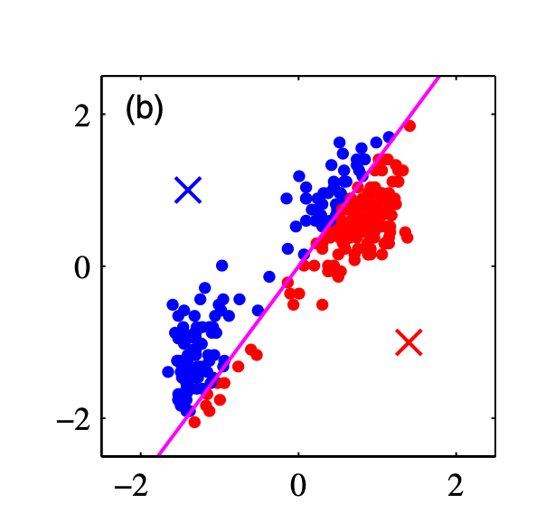
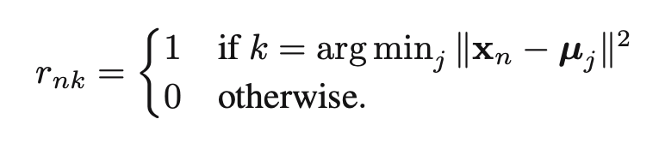
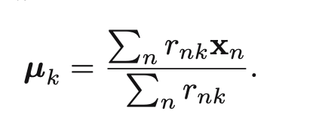
Lloyd’s algorithm for k-means
Start with k
0. Assign initial group assignments r_{nk} somehow
Find group assignments using ||x-μ||²
Update group assignments given mediods
repeat 1.
assign each point to the nearest cluster
change cluster center to the mean of the points

Slide 3
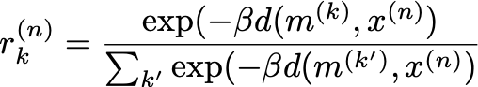
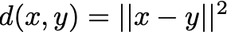
Soft k-means
If the argmin |x – μ| term displeases you, we can use weighted sums (of a function of distance) to put each point a little bit in each class
Assign “degree of assignment” for each point n to each class k
assign part of each point to each cluster
Update means as weighted sum, interpreting exp(-β d(x, m)) as a probability
change cluster center to the mean of the points
MacKay 289

Slide 4
Soft k-means
“Stiffness” hyperparameter β (with units 1 / distance²) changes the argmax function to a continuous function (easier to optimize by gradient descent) that is a ratio of normal densities
Boundaries are still straight lines but are transition regions with widths β^{-1/2}
How do you think we’re going to find β ?

Slide 5
This worked because we inferred the class identities; these are a relevant variable that was hidden from our direct view.
Instead of just inferring the densities (and mixing parameters) we interred a class identity
“Latent variable” is jargon for this kind of variable that was known by the generating process but that must be inferred

Slide 6
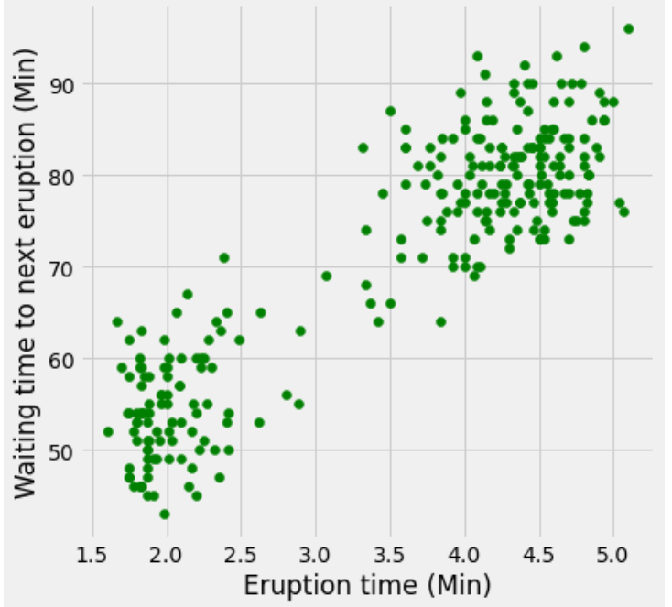
Why normal / function of distance weights?
Achilles heel: fit is catastrophically unstable if x_{i} = μ_{k} for any pair of i and k.

Slide 7
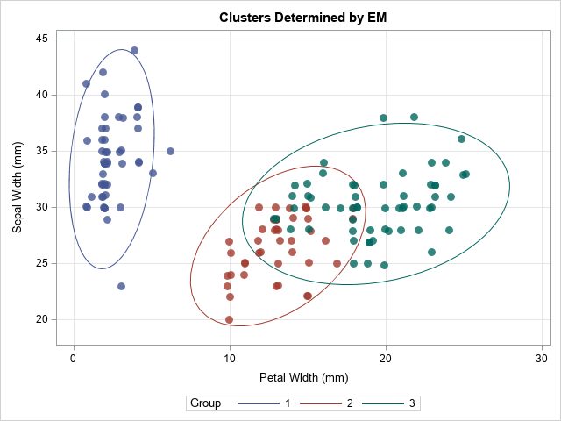
E-M is a generalization of k-means to optimization with latent (often class identity) variables
“Soft” class membership: probability-weighted average
Different geometrical constraint at the boundary between two classes.

Slide 8
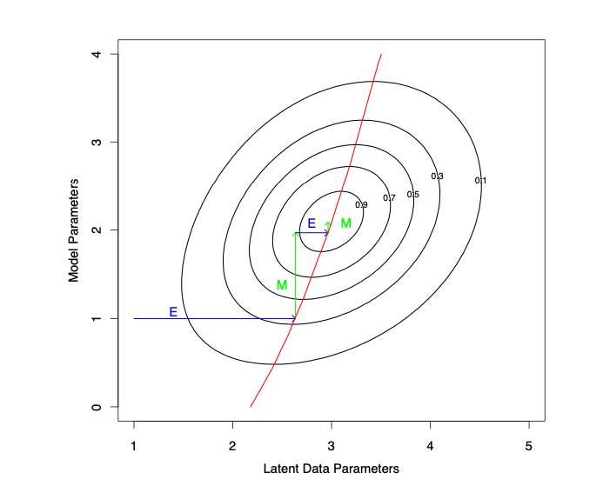
Alternates between updating latent parameters (class labels) and model parameters (class means, variances).
This has a profoundly stabilizing effect on the data-likelihood-search procedure. Frozen class memberships cut the dimensionality of the search.

Slide 9
Clearly this approach gives us freedom to use many parameters.
This model (multivariate normal) finds quadratic decision boundaries, but any probability density would work as long as alternate steps estimate the class labels and use the class label estimates to maximize the parameters.
The caveats of k-means (convergence not guaranteed, different initializations give different answers, gets trapped in local minima, doesn’t know anything but data density) all apply
But we get fancy (and precise-looking mixing parameters, class assignments, and class densities)
Old faithful geyser eruption timing
https://commons.wikimedia.org/wiki/File:EM_Clustering_of_Old_Faithful_data.gif

Slide 10
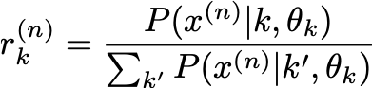
k-means
If the argmin |x – μ| term displeases you, we can use weighted sums (of a function of distance) to put each point a little bit in each class
Assign “degree of assignment” for each point n to each class k as intermediate proability of class label
assign part of each point to each cluster
Update means as weighted sum, interpreting exp(-β d(x, m)) as a probability
change cluster center to the mean of the points
MacKay 289

Slide 11
k-means
If the argmin |x – μ| term displeases you, we can use weighted sums (of a function of distance) to put each point a little bit in each class
Assign “degree of assignment” for each point n to each class k as intermediate proability of class label
Expectation:
change labels
Update means as weighted sum, interpreting exp(-β d(x, m)) as a probability
Maximization:
change parameters
MacKay 289

Slide 12
Expectation-maximization
Assign “degree of assignment” for each point n to each class k using probability that each cluster produced each point
assign part of each point to each cluster
Update means as weighted sum.
change cluster center to the mean of the points
MacKay 289

Slide 13
model selection

Slide 14
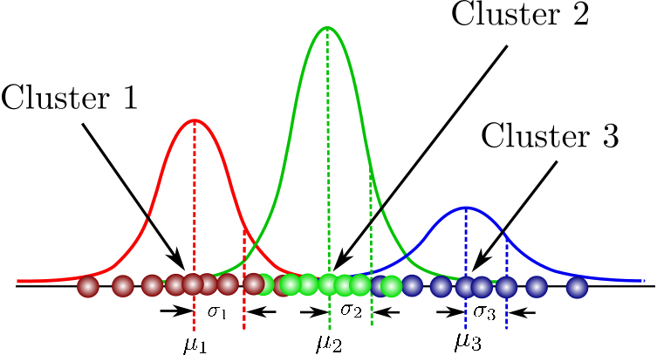
Gaussian mixture model
Easy enough to write down:
mixture coefficients π_{k}
means μ_{k}
standard deviations
or precision matrices Σ_{k}
p(x_{i}|θ) = Σπ_{k}Normal(x_{i}|μ_{k},Σ_{k})

Slide 15
Testing / validation / training
More parameters always gives better fit.
Semantically:
Model selection: find the best model among a handful of alternatives
Model evaluation: estimate the error rate that the model will have on out-of-training-sample data
The need for avoiding bias in model evaluation here gives rise to the
Training / Validation / Test set convention:
The validation set you can peek at the answers to tune hyperparameters (regularization strength, k)
Can’t use cross-validation both for hyperparameter tuning and evaluation.

Slide 16
Bias-Variance decomposition
Total error = Irreducible Error + Bias² + Variance
Note also, if we use a test set that is small, we will have a large variance in our measurement of the error.
How to outrun this problem?
Cross-validation (take multiple testing sets and train model many times) (Expensive, re-trains model many times) (Suited when data are scarce and re-training is not hard)

Slide 17
Simple attacks on model complexity
“Simple” in the sense that they weigh the data mismatch against a function of the number of parameters, without considering the uncertainty in the parameters.
Mallow’s C (GOF score for multiple linear regression; for some linear regression problems equivalent to AIC)
Akaike Information Criterion (Hirotugu Akaike, 1974)
Bayesian Information Criterion (Gideon Schwartz, 1978)

Slide 18
Information Criteria are loss function penalties for overcomplex models
AIC = 2k – 2 LL
BIC = k log(N) – 2 LL
Both are penalties for complexity cast as terms in the loss function
BIC penalizes parameters more harshly
AIC has a frequentist/information theory motivation
k – number of parameters in the model
N – number of data points

